Slide 1
Traffic Signal Detection System
RBE 549- COMPUTER VISION FINAL PROJECT PRESENTATION
Team Members:
Vrushabh Desai, Rishi Madduri, Kavit Shah

Slide 2
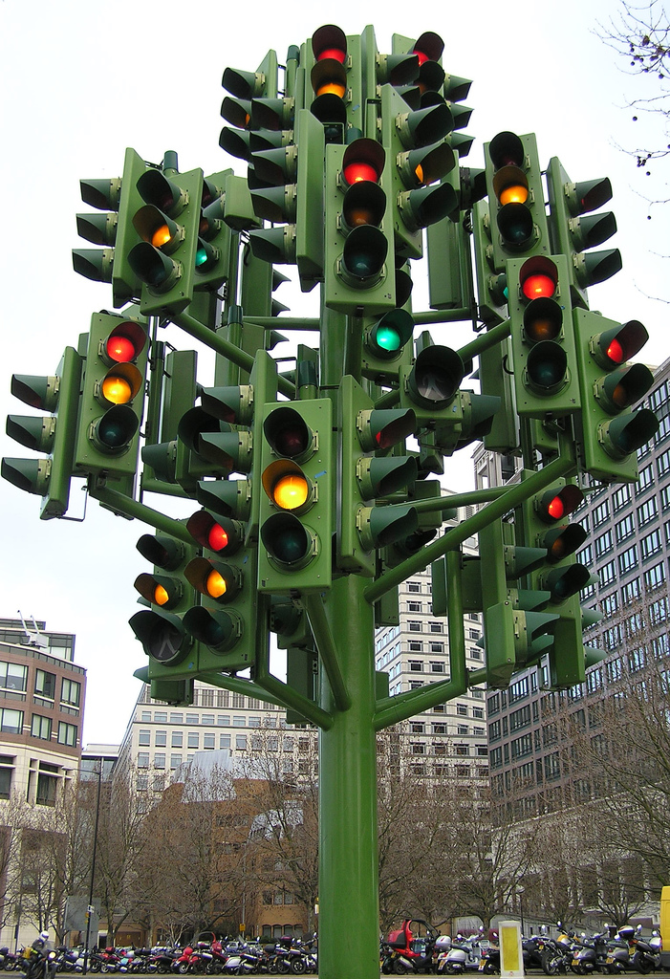
Objectives
Minimum Goals
To implement object detection algorithm to detect traffic lights.
To implement classifier to detect the signals accurately.
Improved Goals
To analyze results using different object recognition algorithms.
To implement YOLO Neural Networks

Slide 3
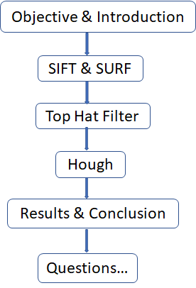
Introduction
Key features of project
Use of Classical Computer Vision Methods:
SIFT and SURF
Top Hat Filter
Hough
YOLO
Neural Networks for Object Detection
Statement of Purpose
To avoid accidents through detecting traffic signals accurately.
To implement robust algorithm to detect signals at day, night, while in motion, etc...

Slide 4
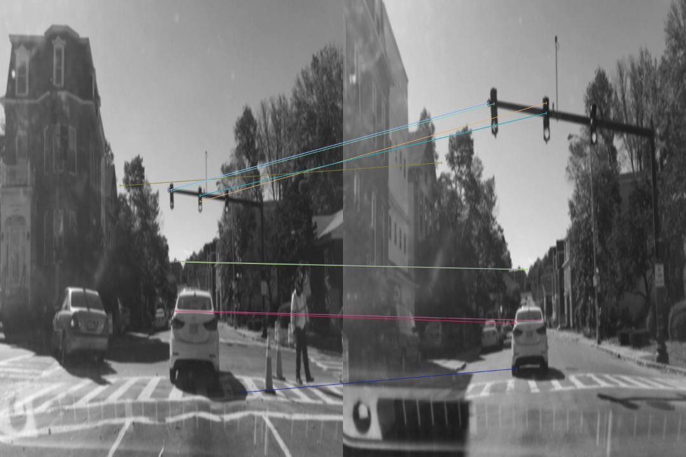
SIFT and SURF

Slide 5
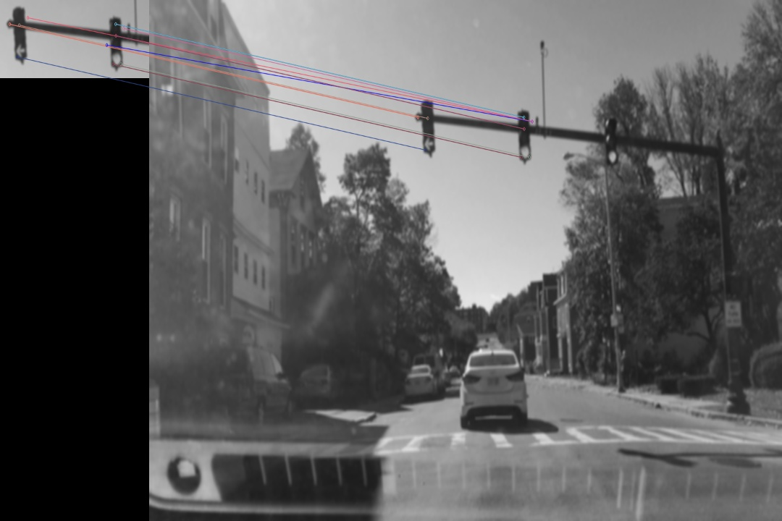
SIFT and SURF

Slide 6
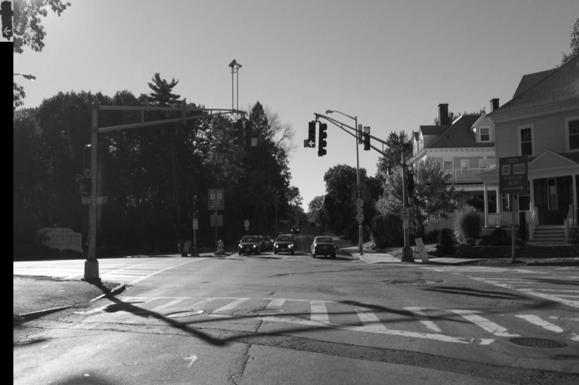
SIFT and SURF

Slide 7
Top Hat Filter:
A Mathematical Morphology Operation
Can Be Used to Extract Details from Image
Two Types of Top Hat Filters:
White Top Hat
Difference between an Input Image and its Opening By a Structural Element
Black Top Hat
Difference between Closing by a Structural Element and Input Image
.

Slide 8
Top Hat Filter Implementation
Read Image
Convert from RGB to Grayscale
Select a structuring element
Opening the image followed by subtraction of the result from the original image
Applying Gaussian Filter to reduce false positives
Applying SURF Feature Detector to detect Key Points
Plotting the Key Points

Slide 9
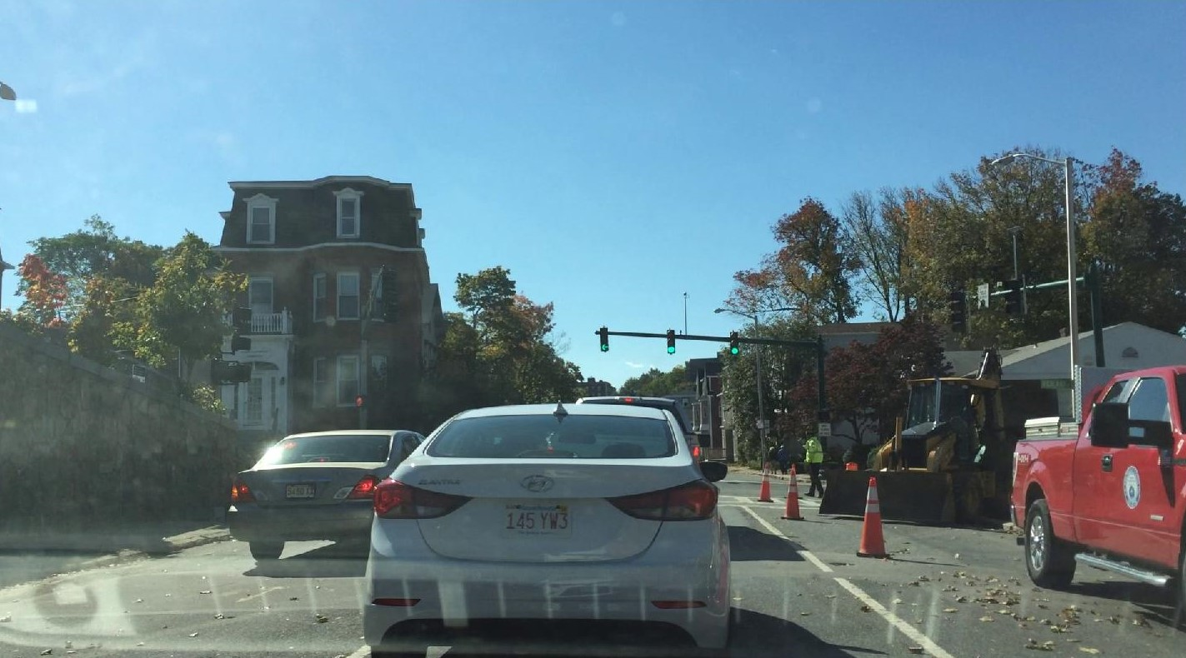
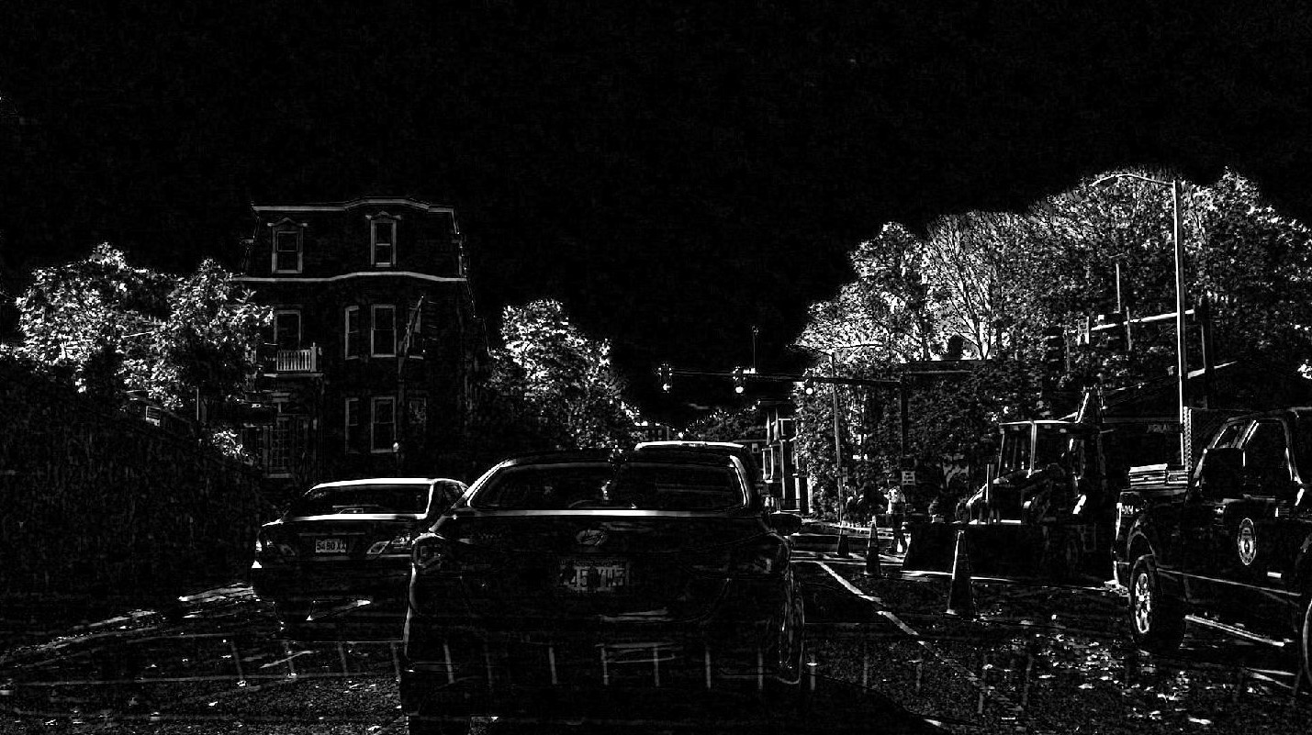
Test-1

Slide 10
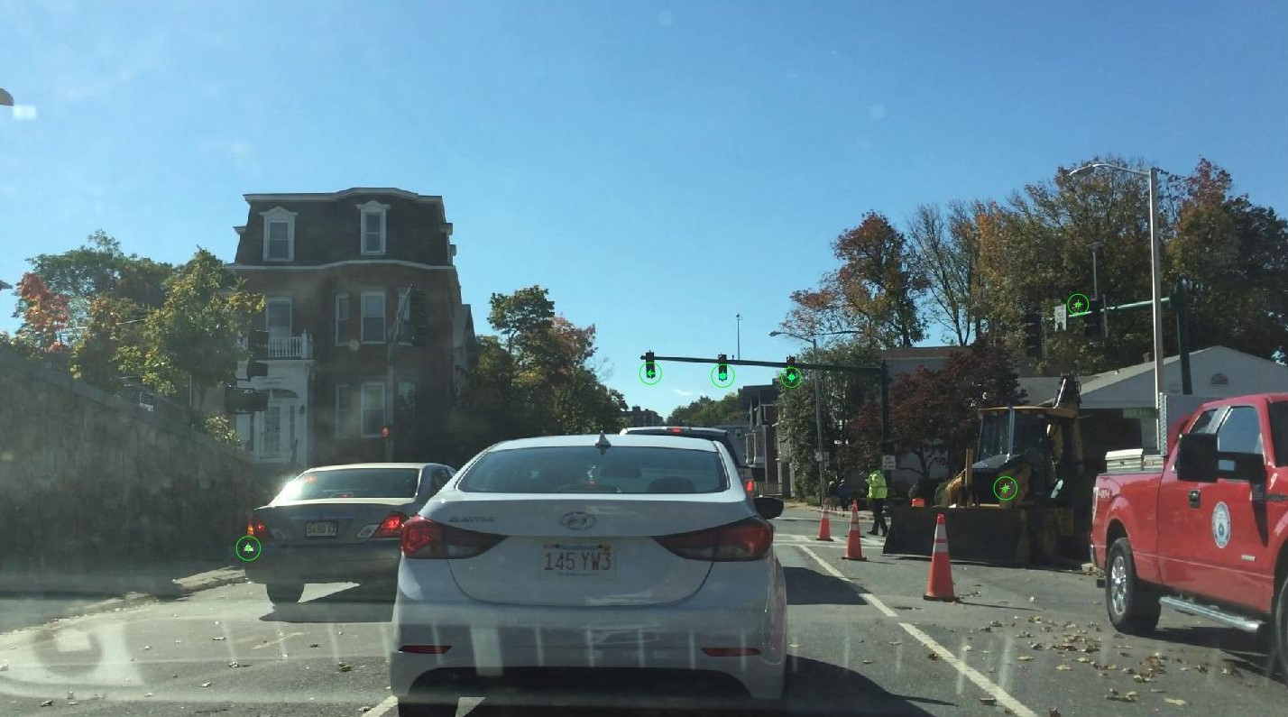

Slide 11
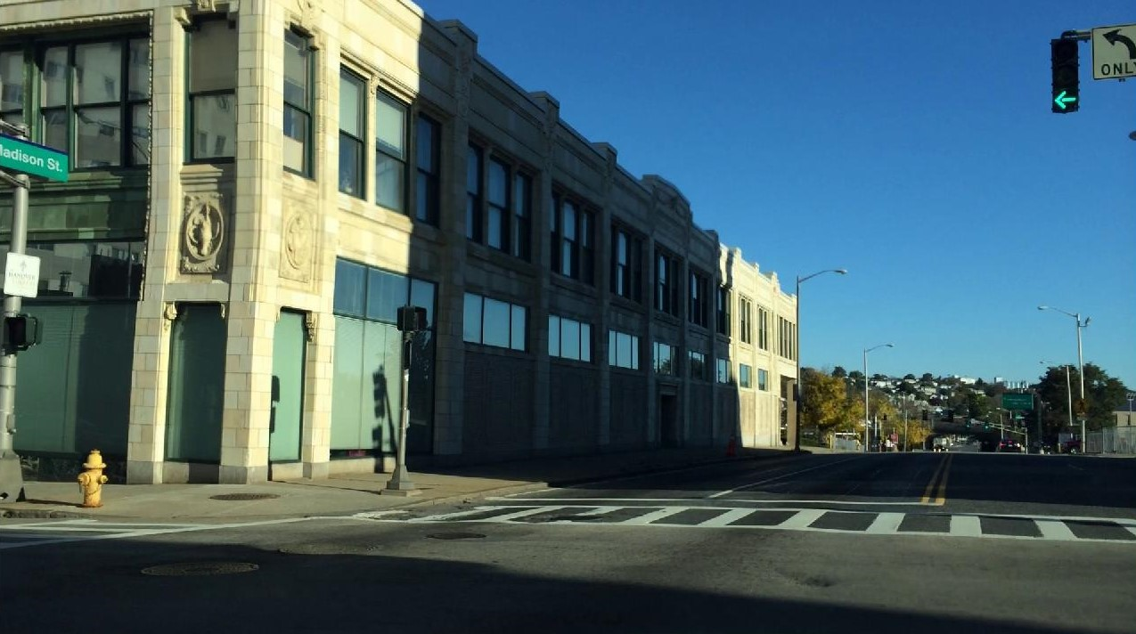
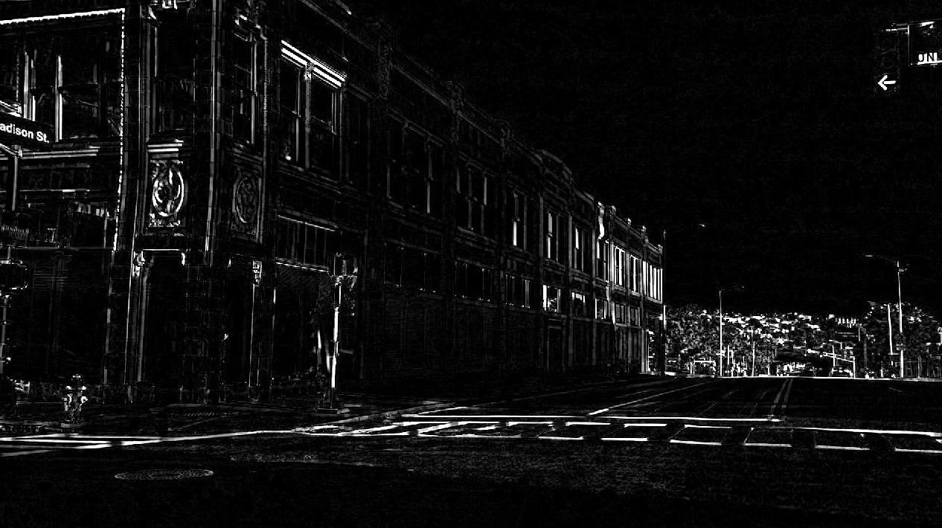
Test 2

Slide 12


Slide 13
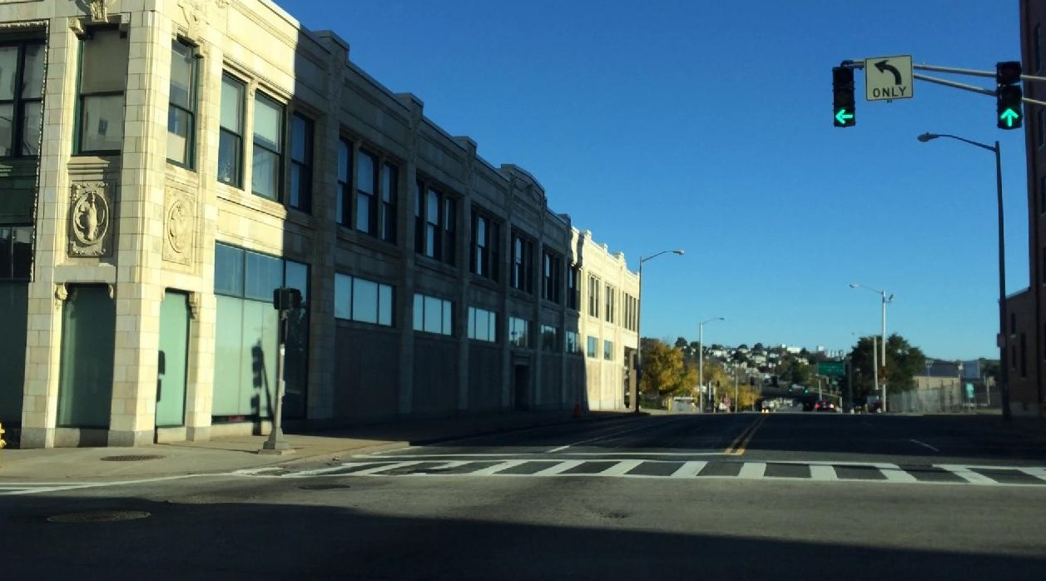
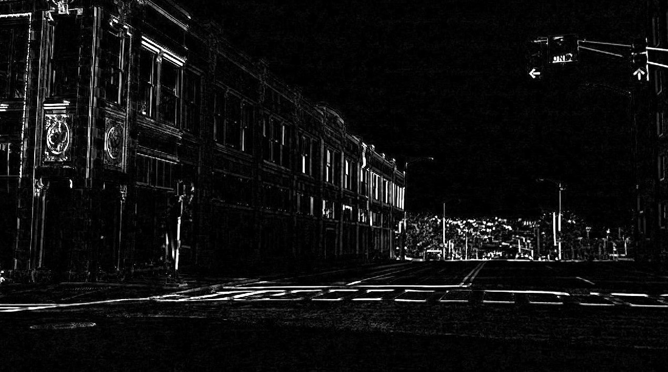
Test 3

Slide 14
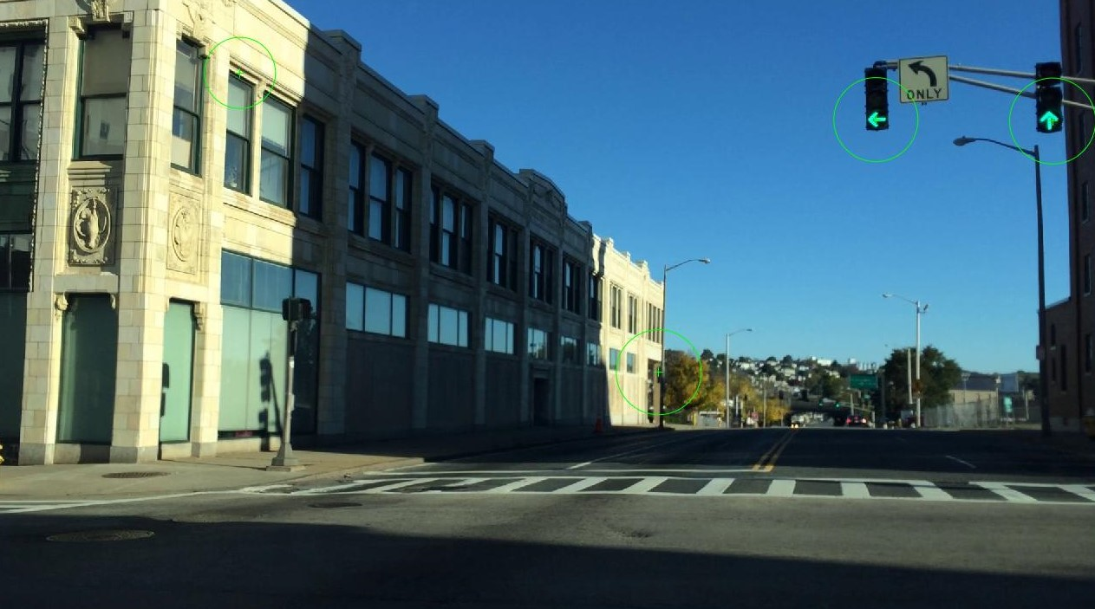

Slide 15
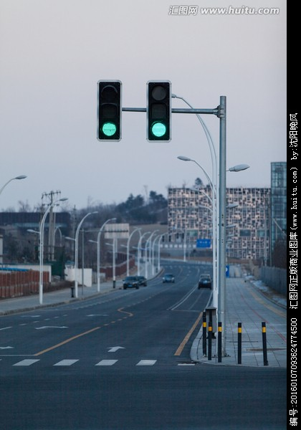
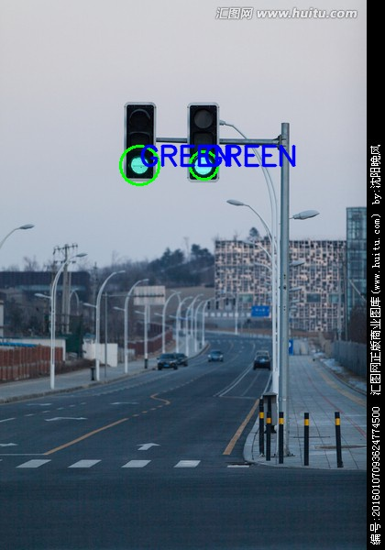
Hough Implementation
Initial steps:
Import image and convert it into HSV colour space
Set colour ranges for red, green and yellow lights.
Hough implementation:
Mask the HSV colour spaces with colour ranges initialized.
Implement Hough to detect circles and get its parameters.
Implement opening for reducing noise.
Draw the circle on detected hough circles.

Slide 16
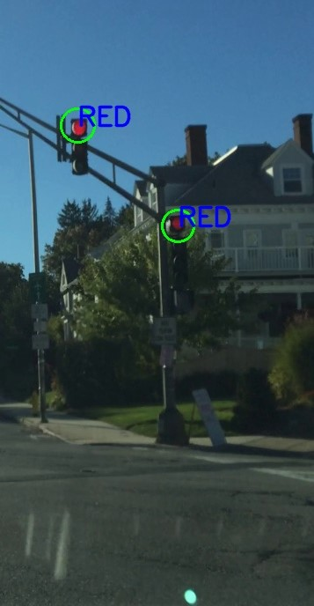
Case-1: Hough on Red lights
Masking:
It recalculates each pixel's value in an image according to a mask matrix.
By applying a mask M on an image I, the pixels of I whose corresponding pixel in M are true are copied into a new image. The rest of the pixels in the new image are set to 0.
From a mathematical point of view we make a weighted average, with our specified values.

Slide 17

Masked image and result after opening
Before opening
After opening

Slide 18
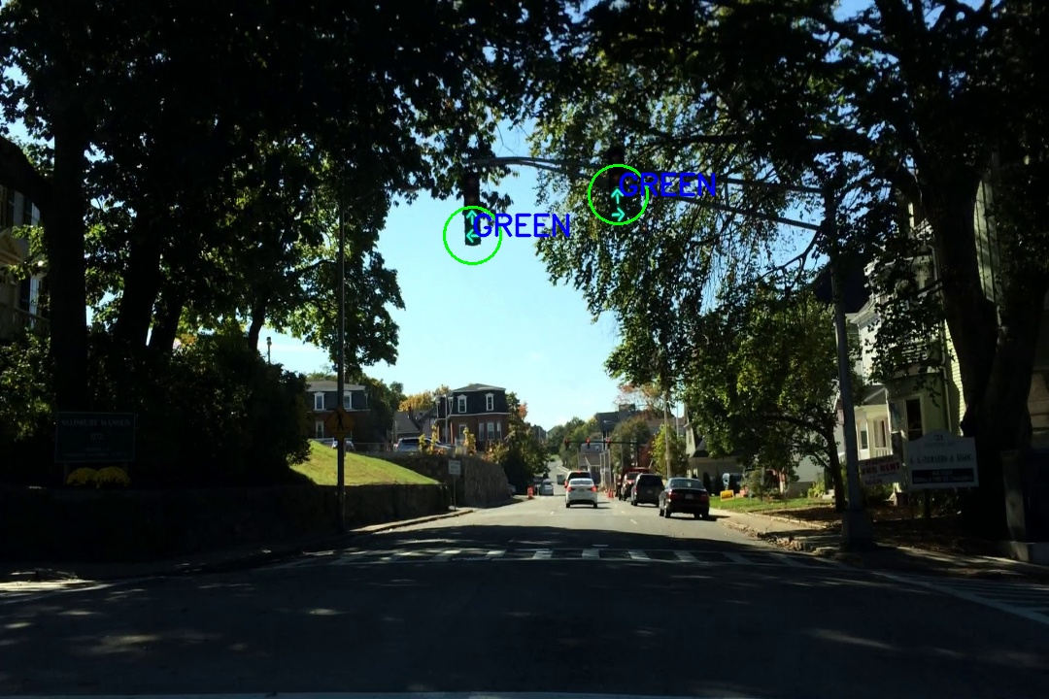
Case-2: Hough on green lights

Slide 19
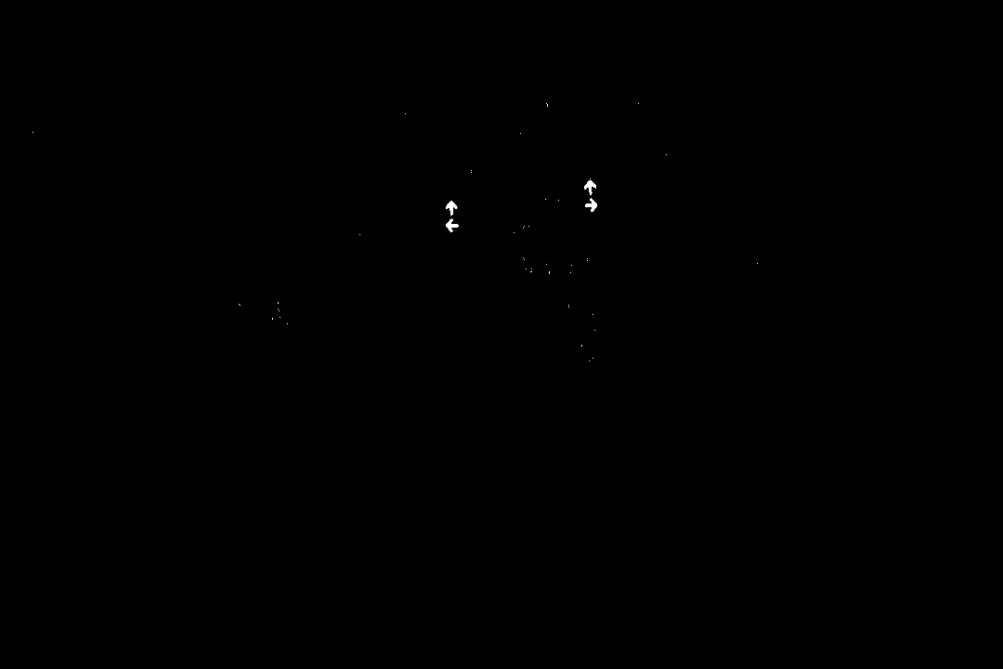
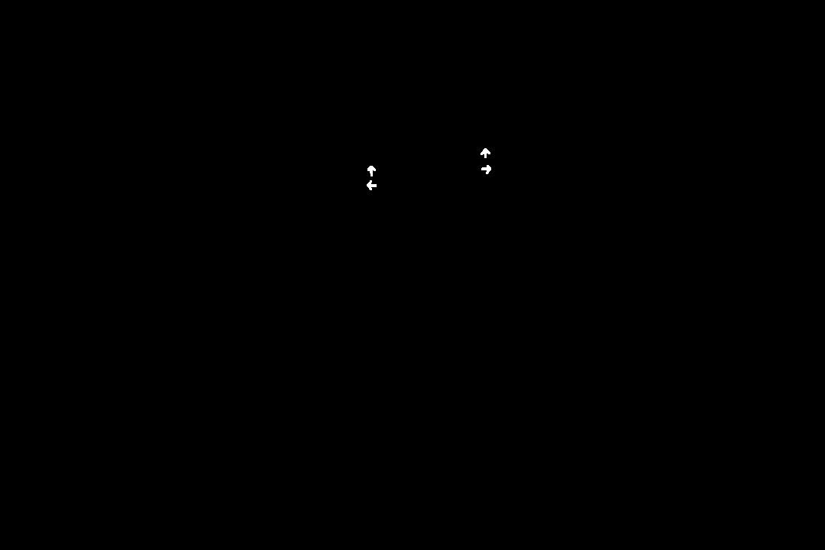
Case-2: Results
Before opening
After opening

Slide 20
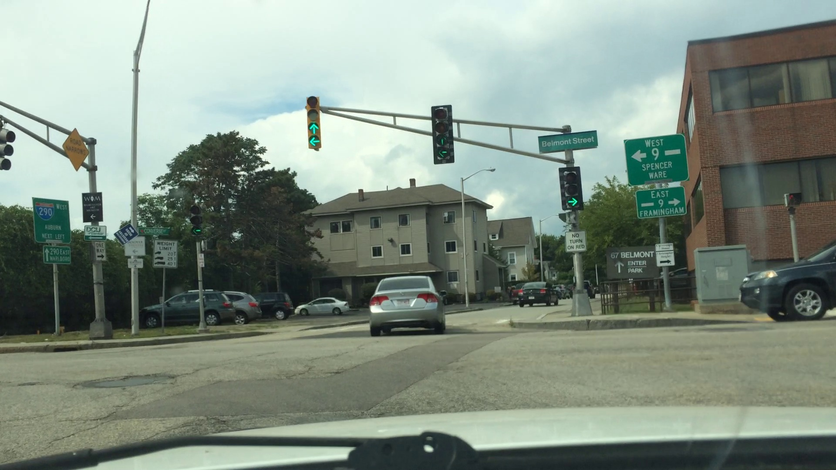
Case-3: Drawback with Hough

Slide 21
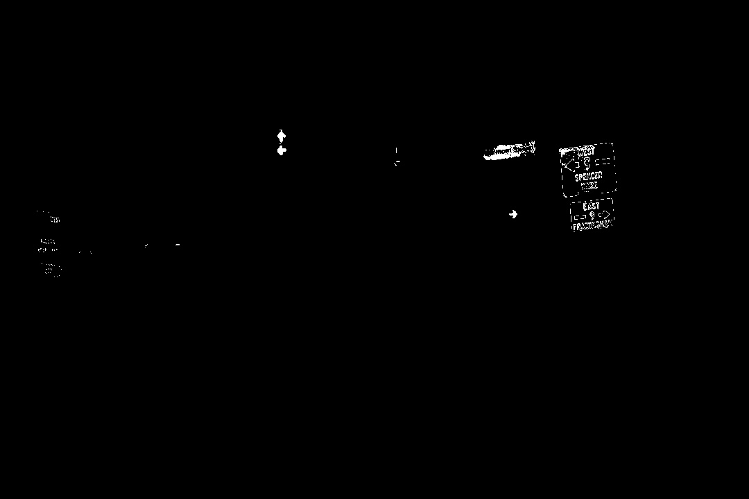

Case-3: Results
Before opening
After opening

Slide 22
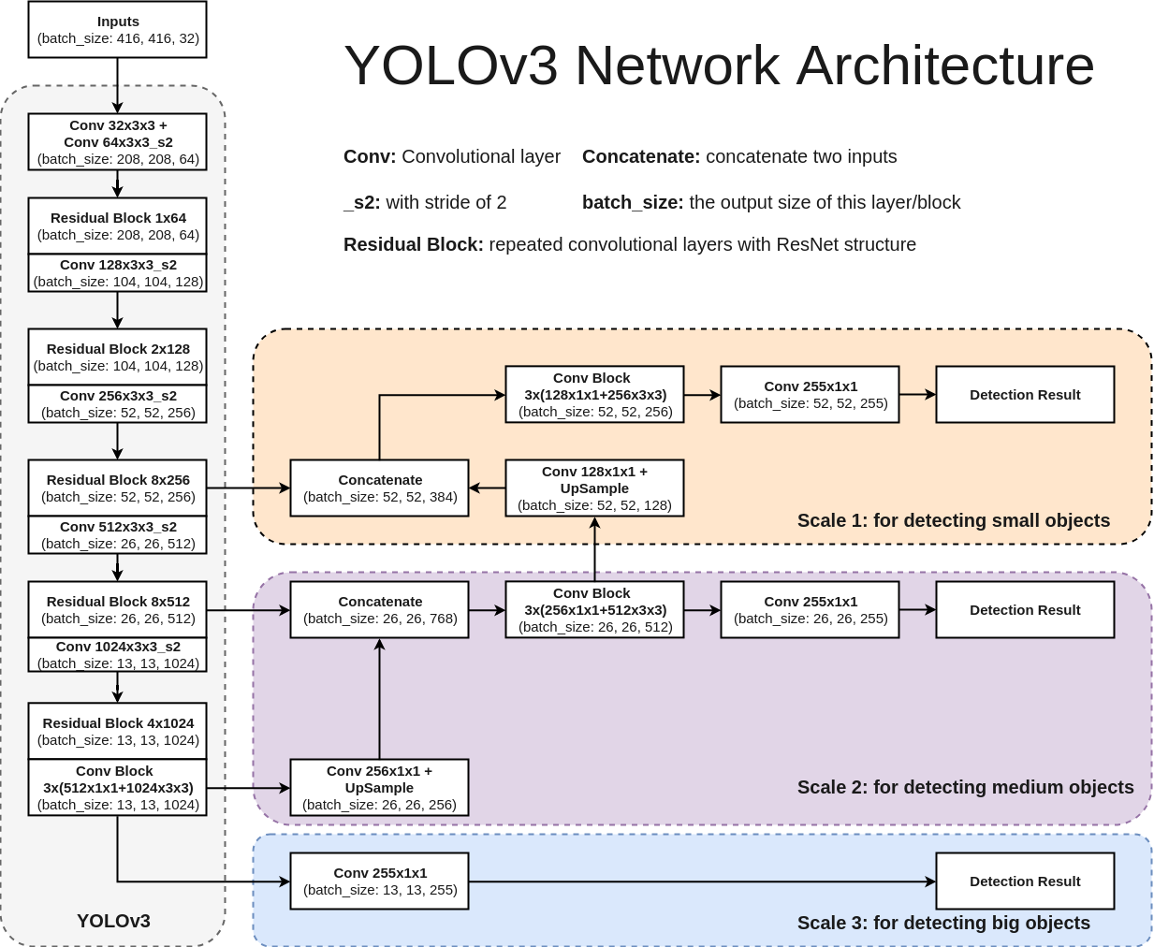
YOLOv3:
Used for real time object detection
It has 106 CNN layer which is used to detect object features in the frame.
Pre-trained model can detect up to 80 different objects (eg: Traffic signal, car, chair, etc.)

Slide 23
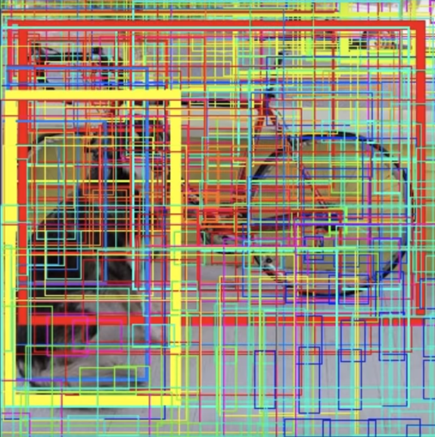
Bounding Box
Network creates a bounding box around the features that could probably be an object.
The width of the box defines the probability or confidence of object belonging to a particular class.
We modified the model to detect traffic light.

Slide 24
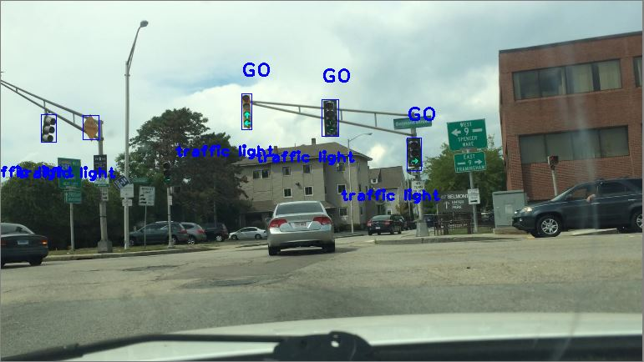
Yolov3 detection on a single Image

Slide 25
Recognition using Thresholding
Red mask
count: 0
Yellow mask
count: 0
Green mask
count: 63
Red mask
count: 0
Yellow mask
count: 0
Green mask
count: 29
Red mask
count: 0
Yellow mask
count: 0
Green mask
count: 43
Declare GO
Declare GO
Declare GO

Slide 26
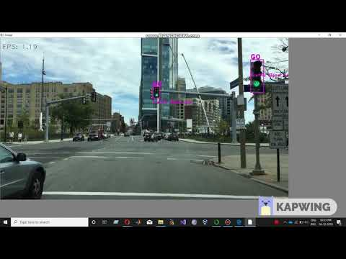
YoloV3 - Real Time Detection

Slide 27
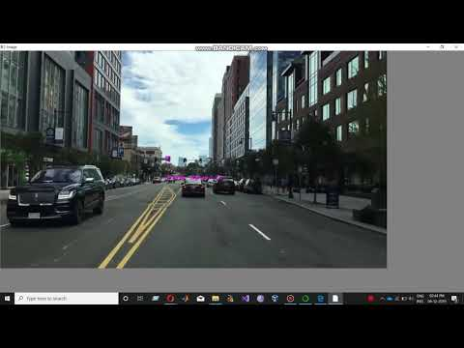
YoloV3 - Real Time Detection

Slide 28
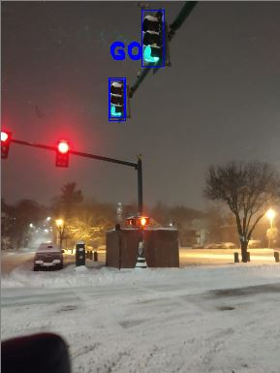
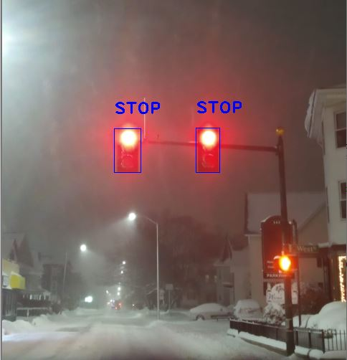
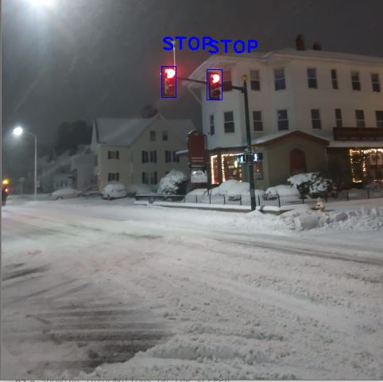
Detection in different lighting conditions

Slide 29
Results and Conclusion
Results:
Successfully implemented different object recognition algorithms.
Implemented YOLO algorithm using pre-trained model to detect traffic signal accurately.
Achieved real-time object recognition
Implemented robust algorithm to detect signals at day, night, while in motion, etc...
Conclusion:
SIFT & SURF: not invariant to change in perspective.
Top Hat filter with SURF: not invariant to change in perspective
Hough Transform: Does not distinguish between the object and the background due to predefined HSV colour space.
Yolov3: Robustly detects traffic signals under different perspectives and lighting conditions

Slide 30
References
[1] Data Set: http://computing.wpi.edu/dataset.html
[2] https://www.cyberailab.com/home/a-closer-look-at-yolov3
[3] https://pjreddie.com/darknet/yolo/
[4] Müller, Julian and Klaus C. J. Dietmayer. “Detecting Traffic Lights by Single Shot Detection.” 2018 21st International Conference on Intelligent Transportation Systems (ITSC) (2018): 266-273.
[5] R. de Charette and F. Nashashibi, "Real time visual traffic lights recognition based on Spot Light Detection and adaptive traffic lights templates," 2009 IEEE Intelligent Vehicles Symposium, Xi'an, 2009, pp. 358-363.
doi: 10.1109/IVS.2009.5164304
[6] https://arxiv.org/abs/1506.02640
[7] R. de Charette and F. Nashashibi, "Traffic light recognition using image processing compared to learning processes," 2009 IEEE/RSJ International Conference on Intelligent Robots and Systems, St. Louis, MO, 2009, pp. 333-338.
doi: 10.1109/IROS.2009.5353941

Slide 31
THANK YOU!

